Slide 1
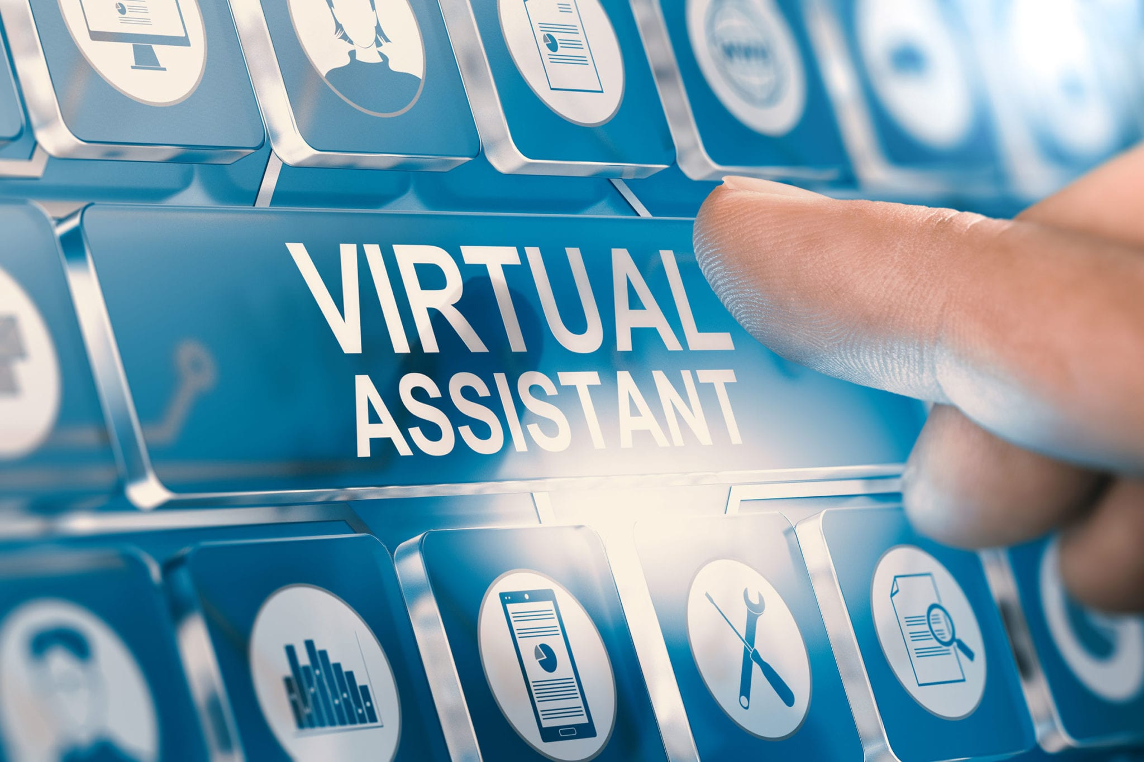
Virtual Speaking
Assistant (JERRY 1.0)
Team members :
1. Ayush Rana (19BCS1143)
2. Prajwal Sharma (19BCS1144)

Slide 2

CONTENT :
Introduction & History
About This Project
Benefits & Work Area
Diagrams
Structure
Working
Team Work
What we learned

Slide 3
INTRODUCTION & HISTORY
• An intelligent virtual assistant (IVA) or speaking assistant is a software that can perform tasks
or services for an individual based on commands or questions. The term "chatbot" is sometimes
used to refer to virtual assistants generally or specifically accessed by online chat.
• In some cases, online chat programs are exclusively for entertainment purposes. Some virtual assistants are able to interpret human speech and respond via synthesized voices. Users can ask their assistants questions, control home automation devices and media playback via voice, and manage other basic tasks such as email, to-do lists, and calendars with verbal (spoken?) commands.
• A similar concept, however with differences, lays under the dialogue systems. As of 2017, the capabilities and usage of virtual assistants are expanding rapidly, with new products entering the market and a strong emphasis on both email and voice user interfaces.
• Apple and Google have large installed bases of users on smartphones. Microsoft has a large installed base of Windows-based personal computers, smartphones and smart speakers. Amazon has a large install base for smart speakers. Convers Ica has over 100 million engagements via its email and SMS interface Intelligent Virtual Assistants for business.

Slide 4
INTRODUCTION & HISTORY
• The 1990s digital speech recognition technology became a feature of the personal computer with IBM, Philips and Lemout & Hauspie fighting for customers. Much later the market launch of the
first smartphone IBM Simon in 1994 laid the foundation for smart virtual assistants as we know
them today.
• In 1997 Dragon’s Naturally Speaking software could recognize and transcribe natural human
speech without pauses between each word into a document at a rate of 100 words per minute. A
version of Naturally Speaking is still available for download and it is still used today, for instance,
by many doctors in the US and the UK to document their medical records.
• The first modern digital virtual assistant installed on a smartphone was Siri, which was introduced
as a feature of the iPhone 4S on 4 October 2011. Apple Inc. developed Siri following the 2010
acquisition of Siri Inc. a spin-off of SRI International, which is a research institute financed by
DARPA and the United States Department of Defense.
• In November 2014, Amazon announced Alexa alongside the Echo.
In April 2017 Amazon released a service for building conversational interfaces for any type of
virtual assistant or interface.

Slide 5

ABOUT THIS PROJECT
DEFINITION : A virtual assistant is an application program that understands natural language voice commands and completes tasks for a user, while providing a variety of remote services to a business.
• Jerry is an AI speaking virtual assistant made for performing some basic but important tasks. Just by listening he can perform some tasks and also he can talk with the user.

Slide 6
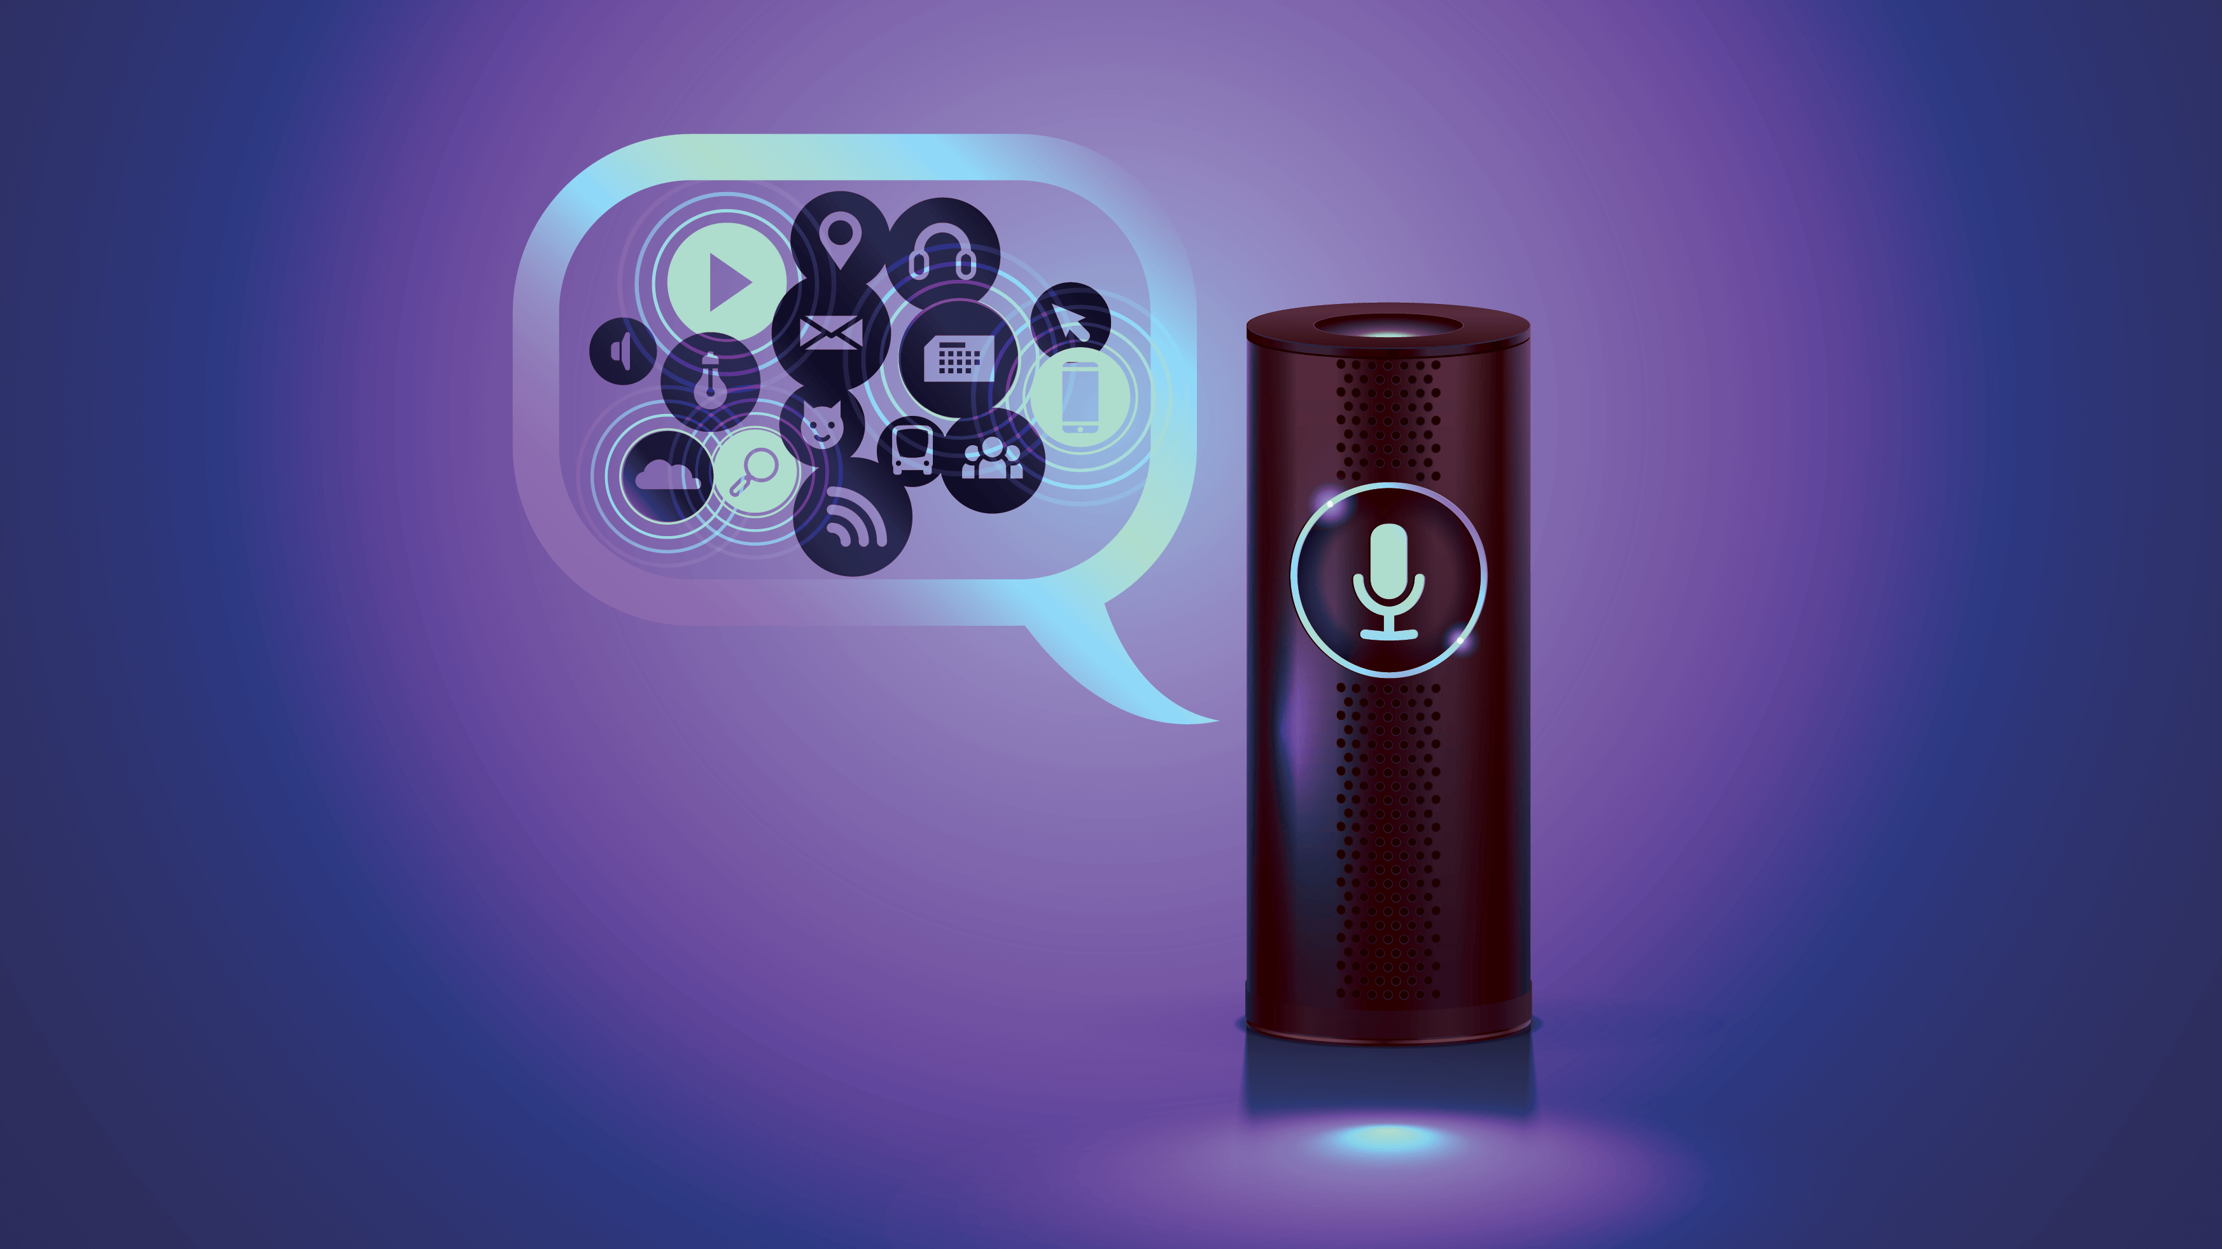
ABOUT THIS PROJECT
Tasks performed by JERRY :
Talking to the user.
Doing some useful functions like :
a) Opening Google.
b) Opening Youtube.
c) Opening Stackoverflow.
d) Searching from Wikipedia.
e) Telling the current time.
f) Opening some useful folders.
g) Playing music.
h) Capturing picture.
3. Exiting itself on command.

Slide 7
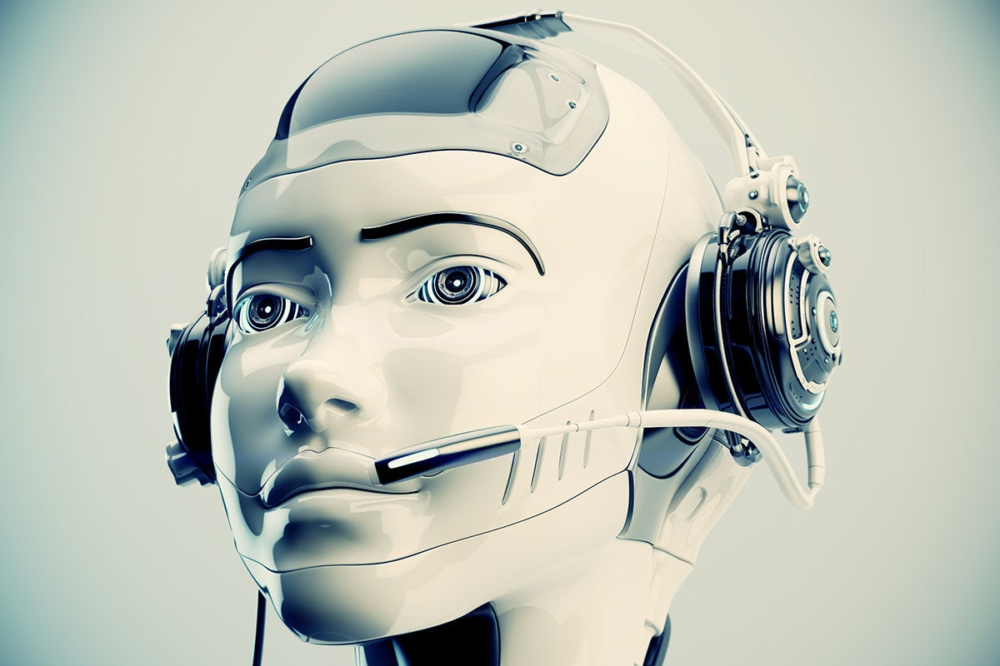
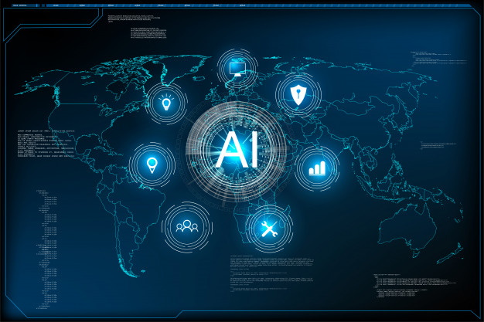
BENEFITS & WORK AREA
=> Having an AI Virtual assistant is very interactive and enjoyable. Also it can reduce our work load.
WORK AREAS :
Perform various tasks according to the need of user.
Time saving for other works as it operates on various things single handedly.
User do not have to put extra efforts he just have to give some commands and tasks will be executed by Jerry.

Slide 8
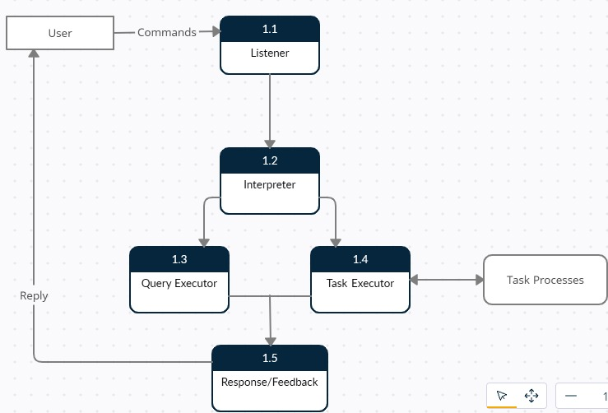
DIAGRAMS
DFD :

Slide 9
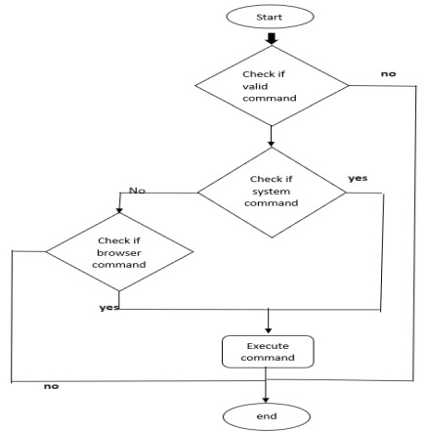
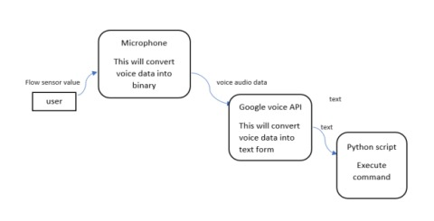
DIAGRAMS
DATA FLOW CHART :

Slide 10
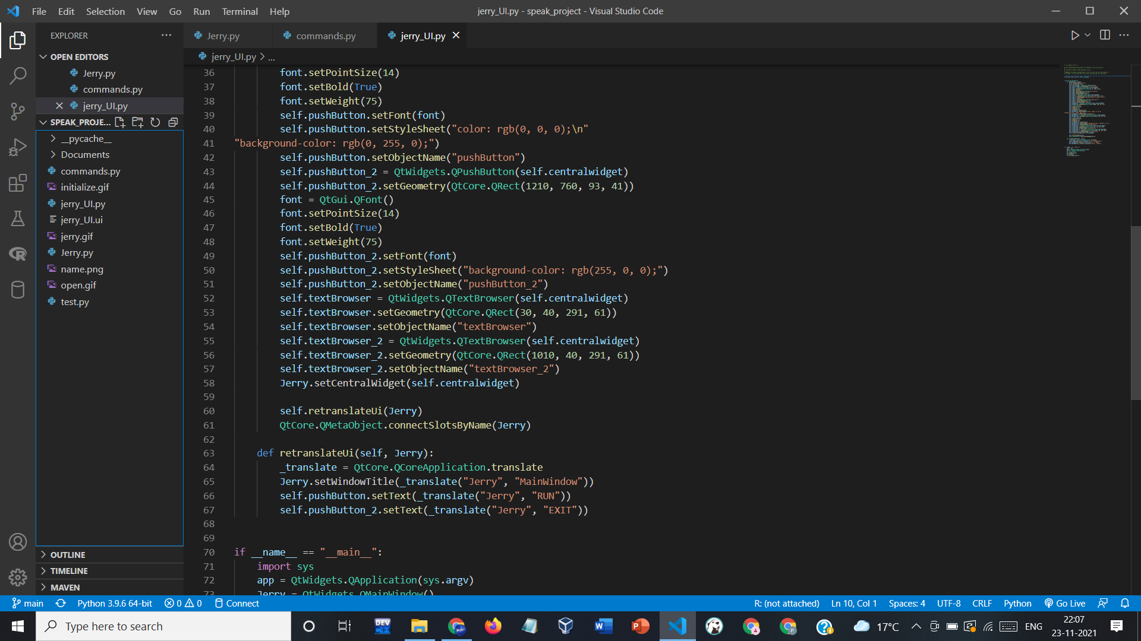
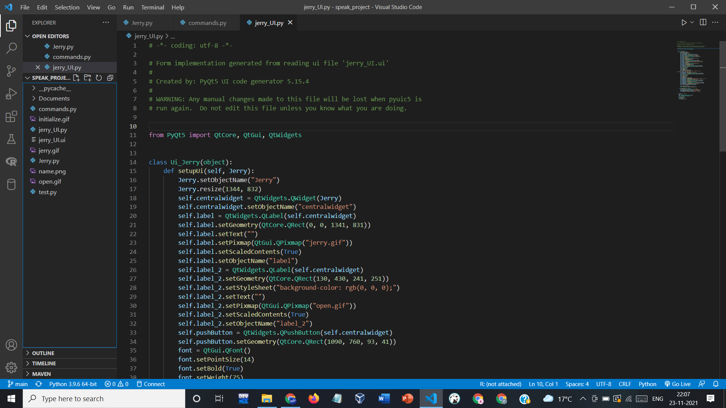
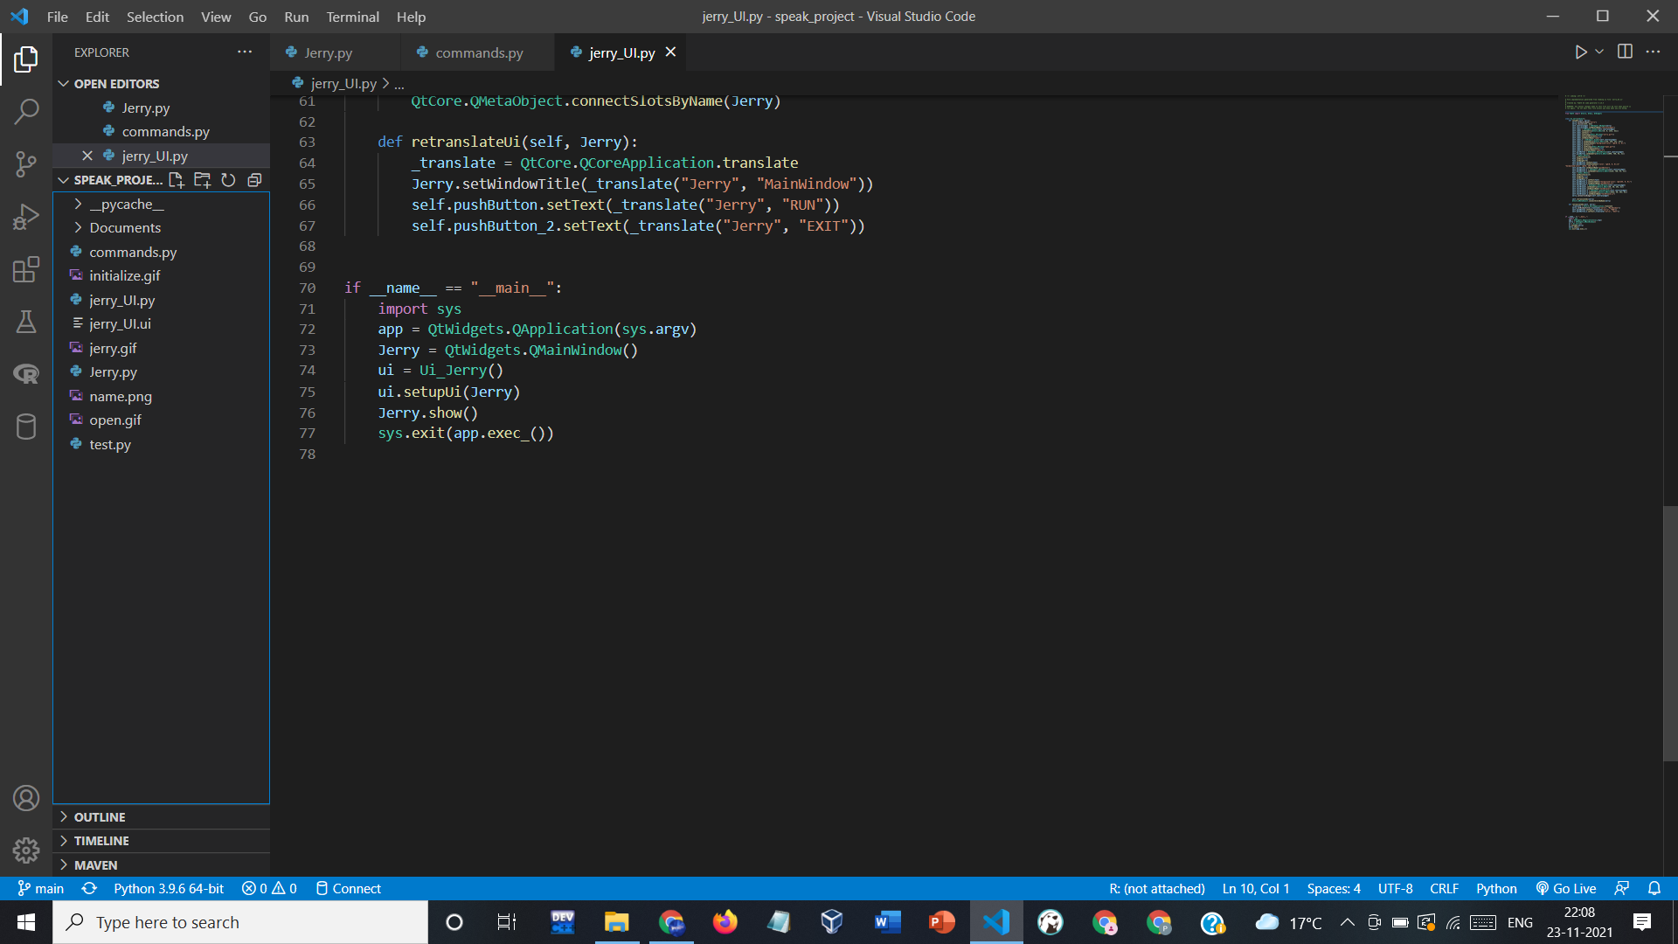
STRUCTURE
1. USER INTERFACE (UI) :

Slide 11
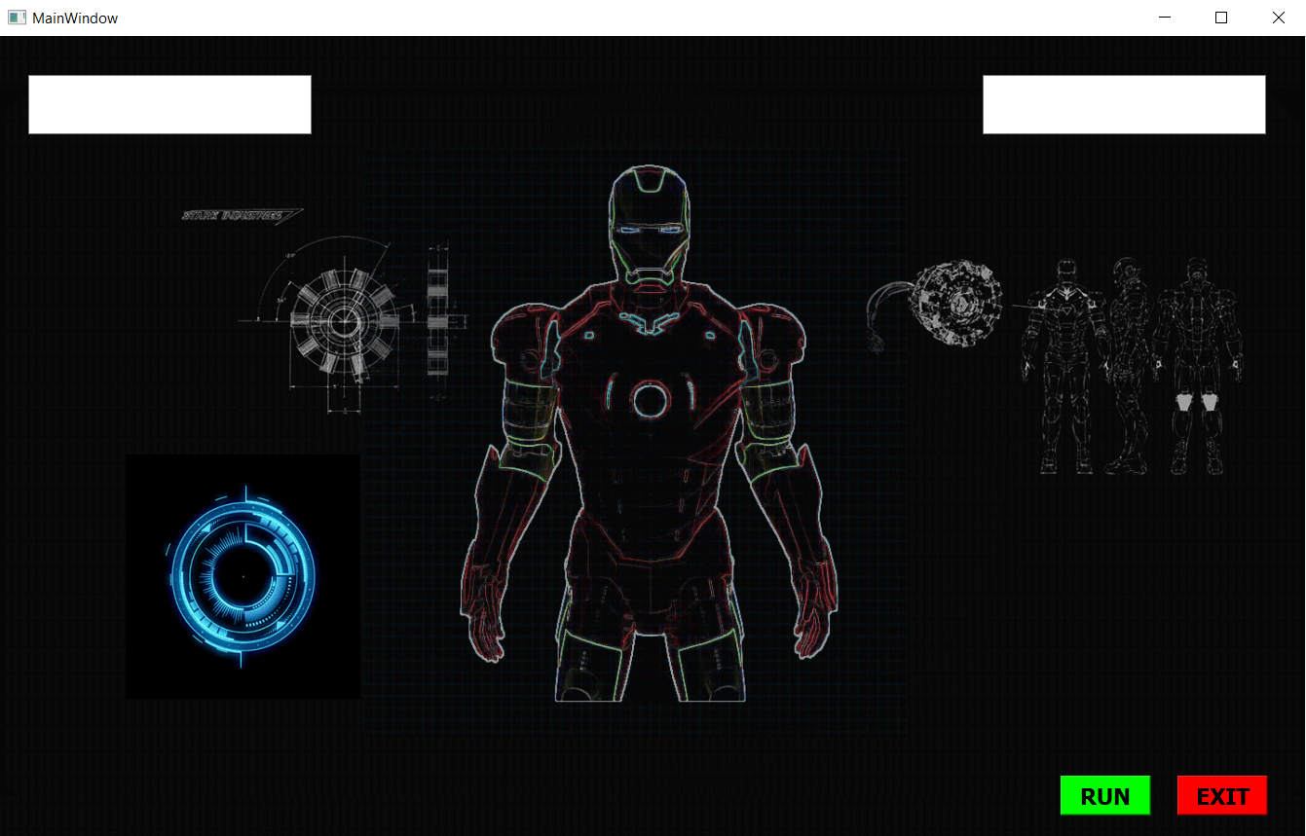
STRUCTURE
1. USER INTERFACE (UI) :

Slide 12
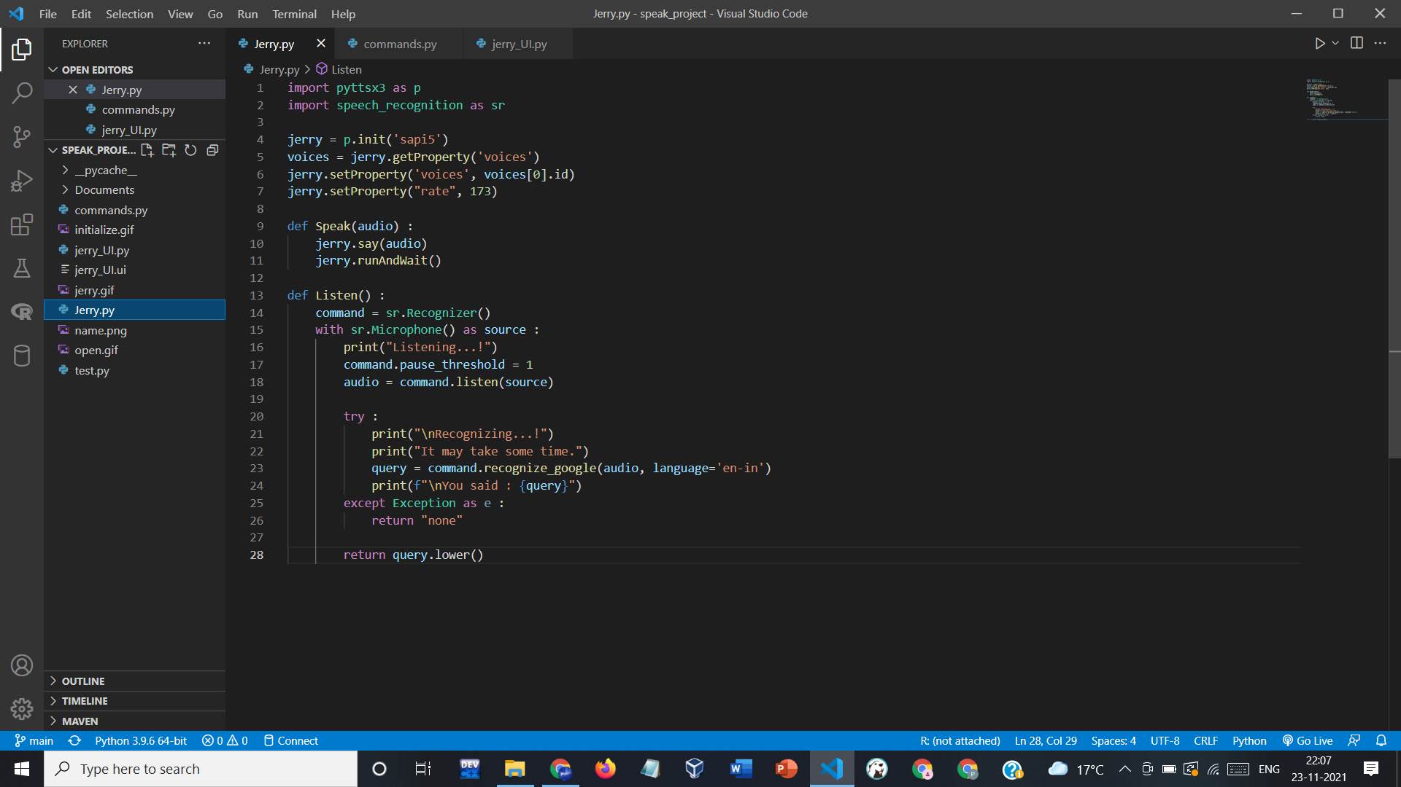
2. FUNCTIONING :

Slide 13
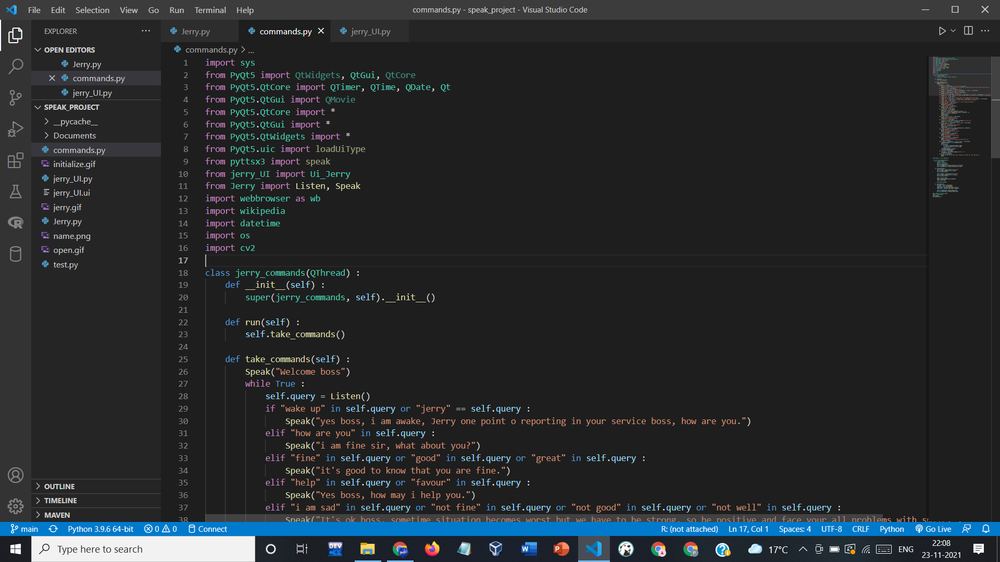
3. COMMANDS :

Slide 14
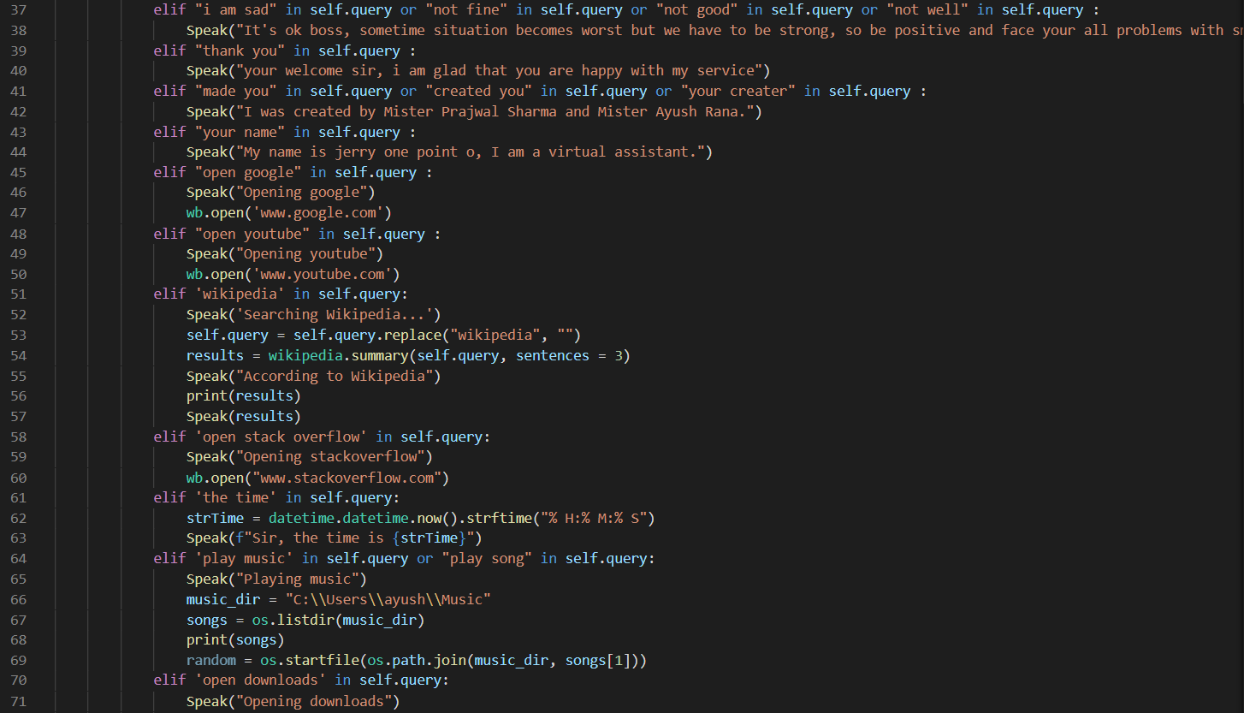
3. COMMANDS :

Slide 15
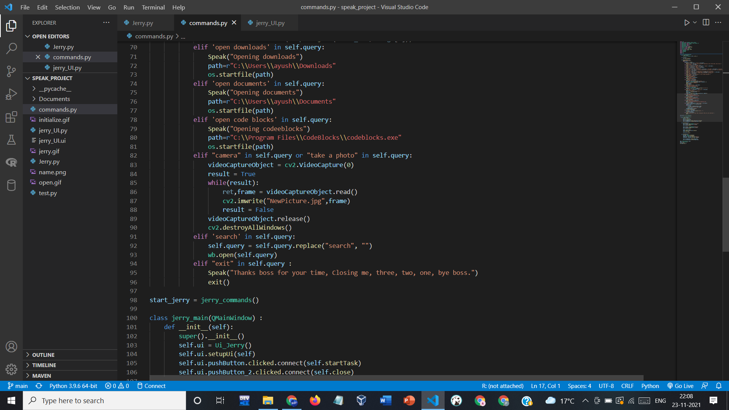
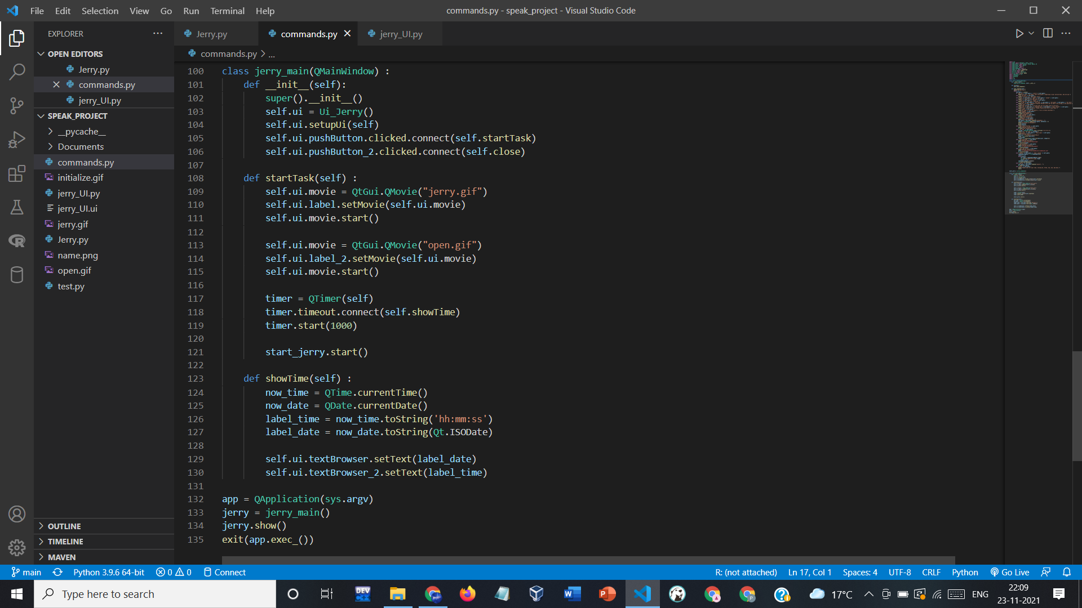
3. COMMANDS :

Slide 16
WORKING
Here’s the implementation of our project. Below is the front end page that is displayed when we first open our software.
Initially, We have to press the RUN button to start JERRY.

Slide 17
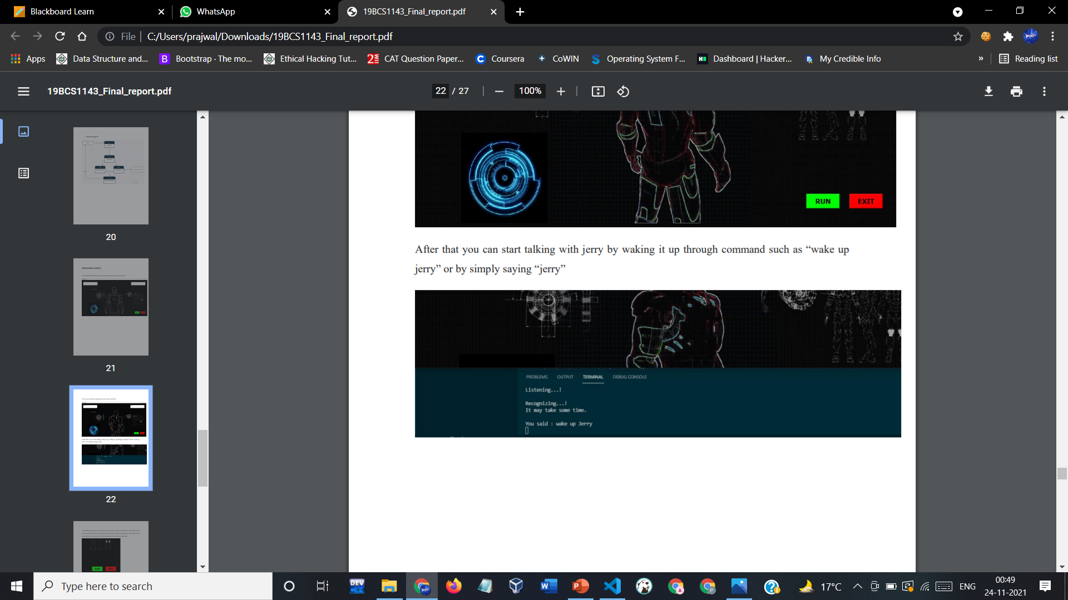
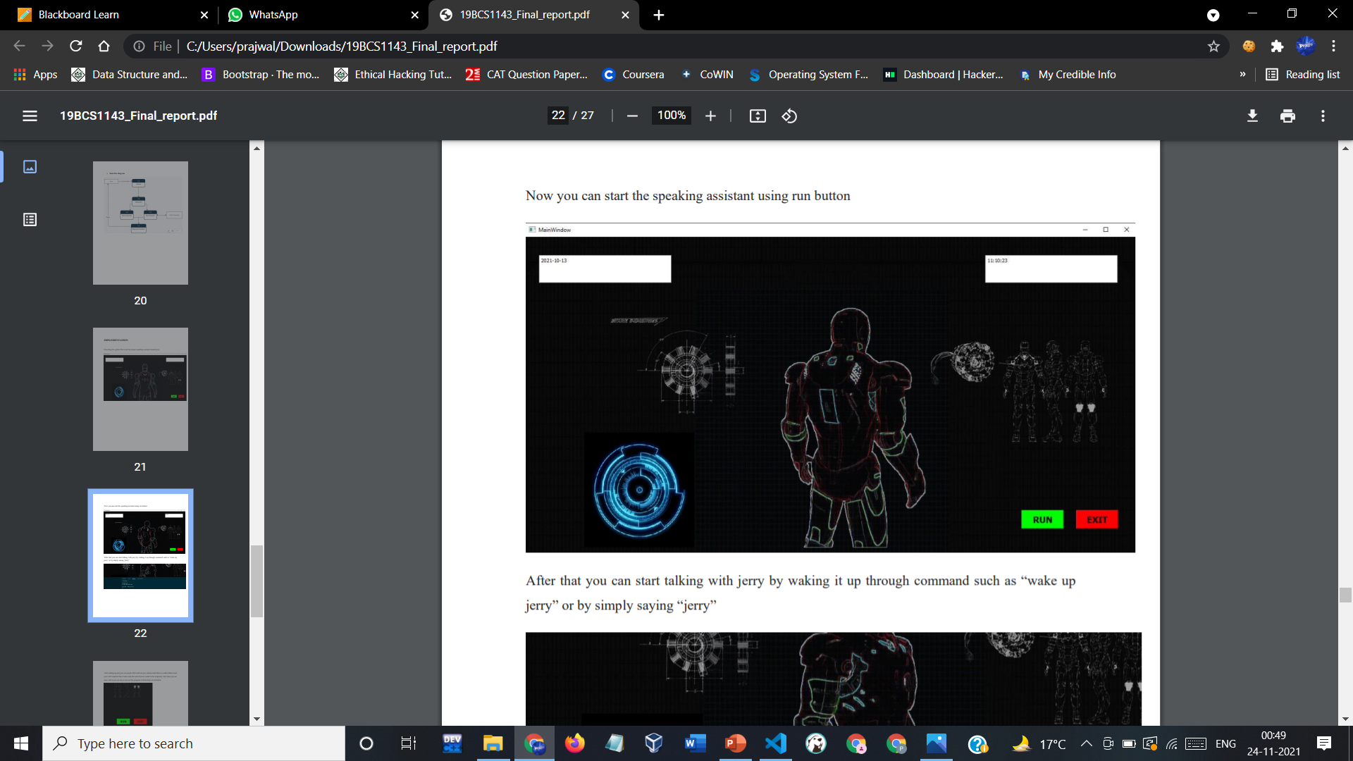
WORKING
After that you can start talking with jerry by waking it up through command such as “wake up jerry” or by simply saying “jerry”.

Slide 18
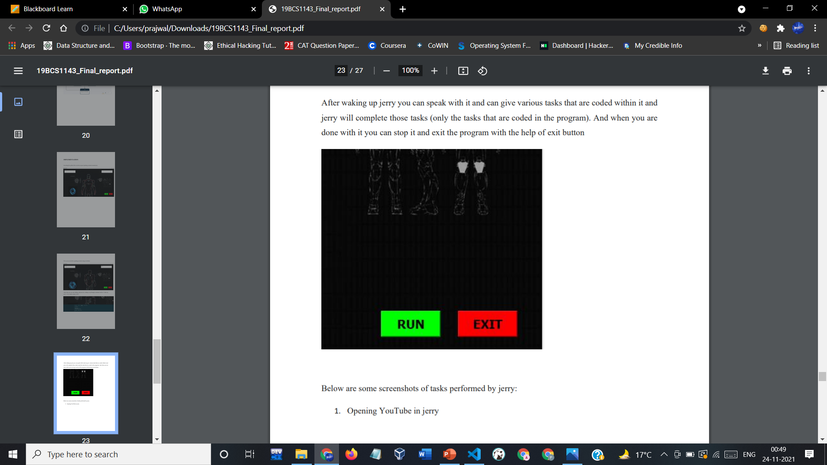
WORKING
After waking up jerry you can speak with it and can give various tasks that are coded within it and jerry will complete those tasks (only the tasks that are coded in the program). And when you are done with it you can stop it and exit the program with the help of exit button

Slide 19
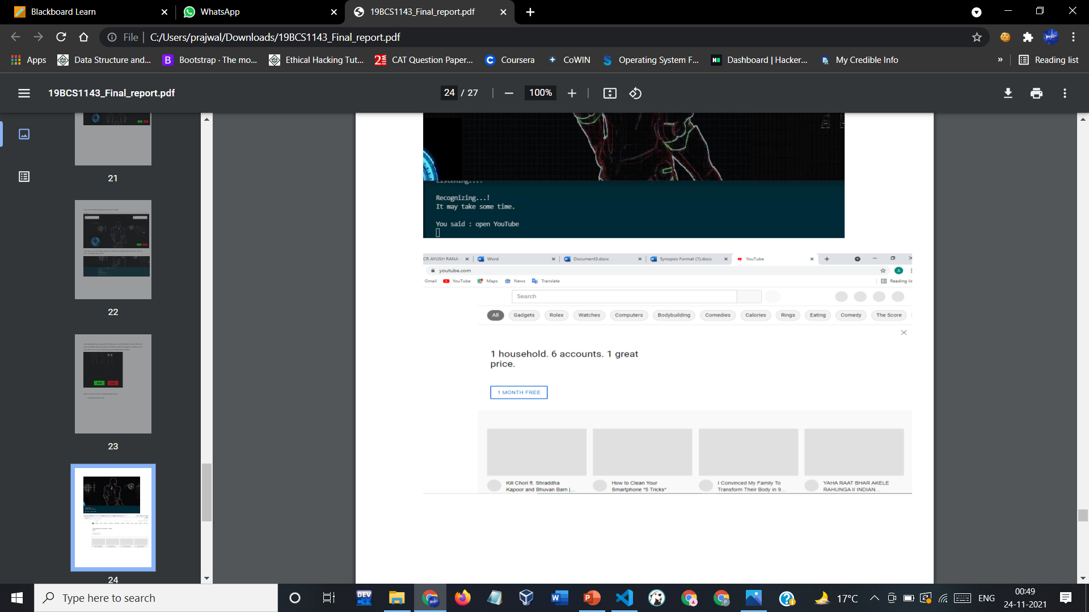
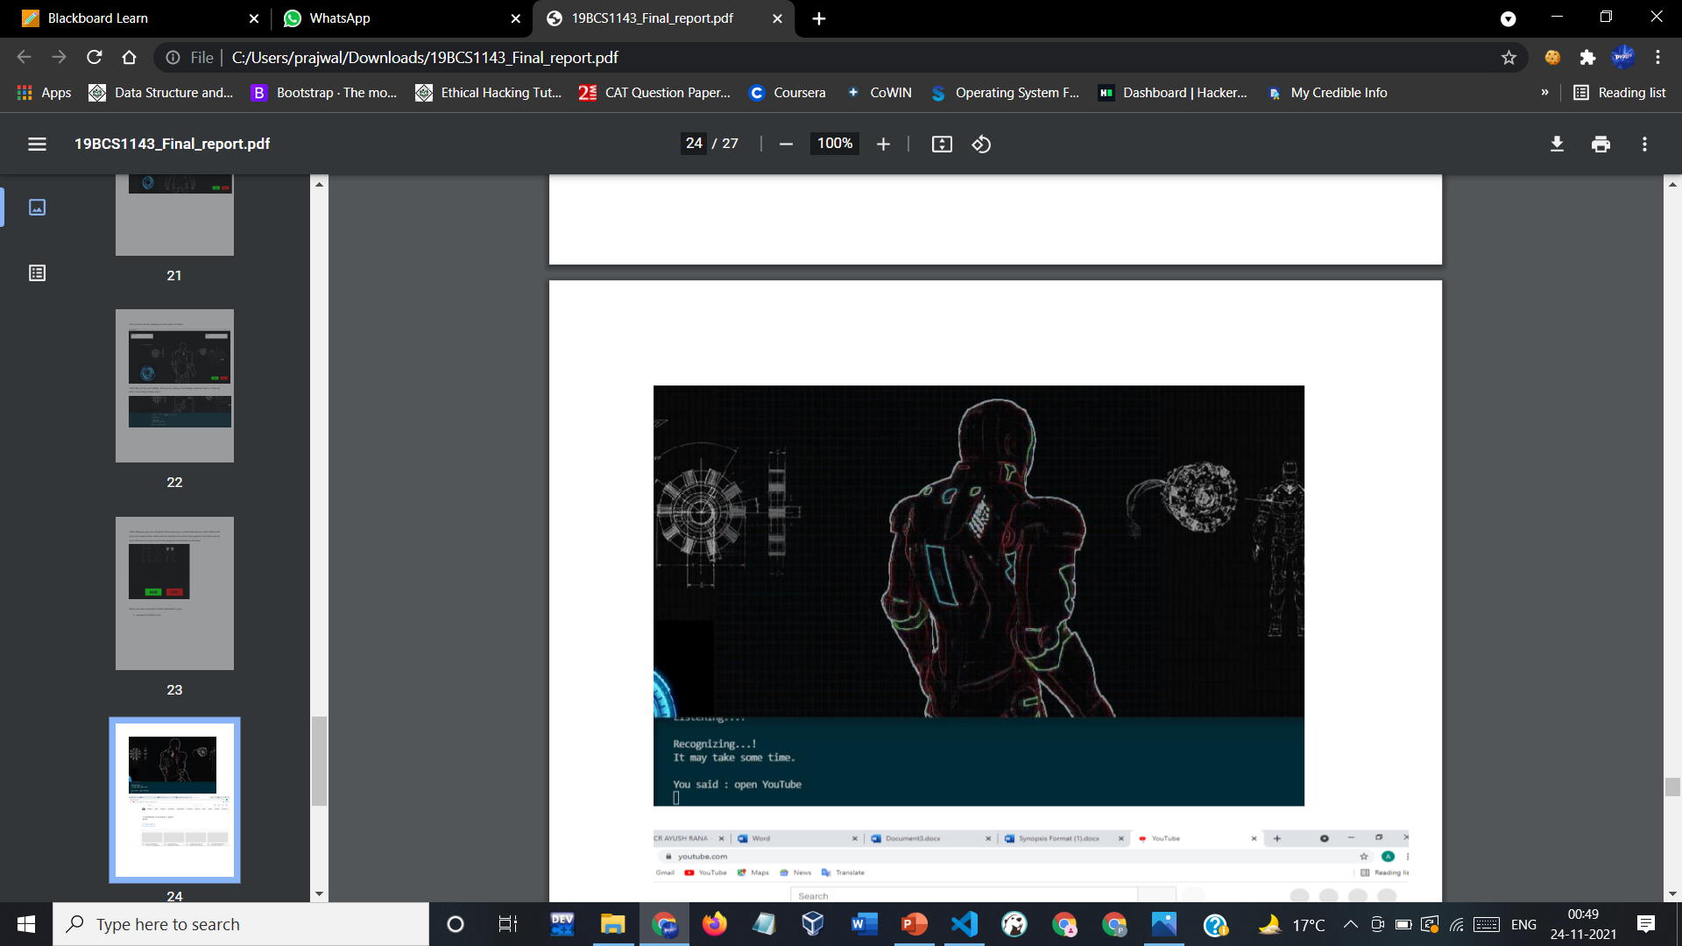
WORKING
Below are some screenshots of tasks performed by jerry :
1. Opening YouTube in jerry

Slide 20
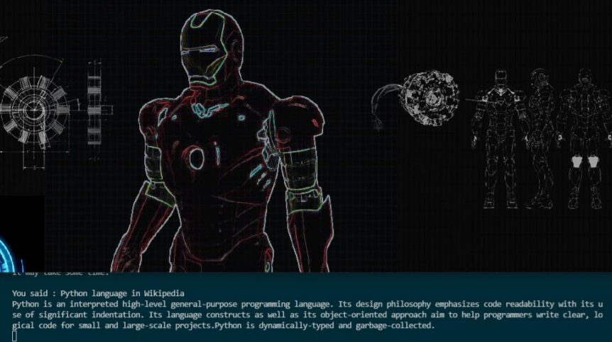
WORKING
2. Searching in Wikipedia

Slide 21
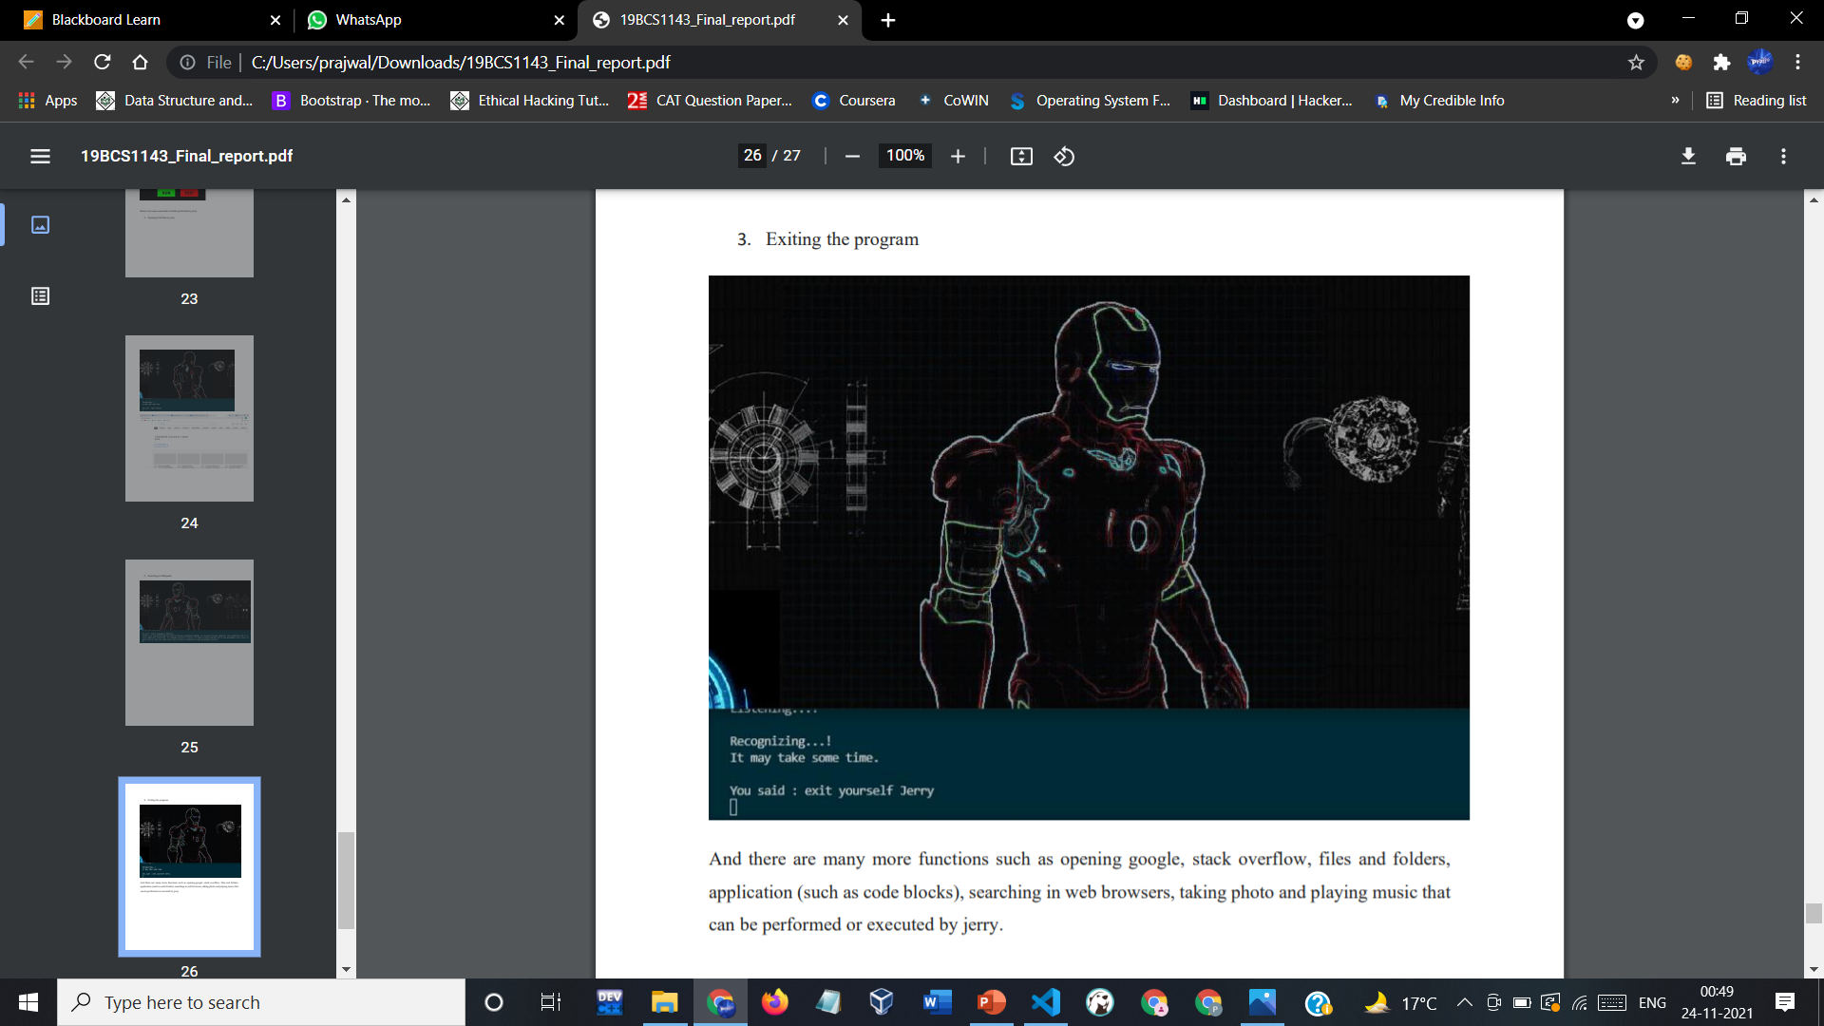
WORKING
3. Exiting the program
And there are many more functions such as opening google, stack overflow, files and folders,
application (such as code blocks), searching in web browsers, taking photo and playing music that can be performed or executed by jerry.

Slide 22
TEAM WORK
Throughout the project building and documentation process, we have worked as a team and have learned a lot from each other working in a team. We shared each other’s ideas and brainstormed on a lot of topics which finally led us to build this amazing software ourselves. Here, is what each one of us was majorly focusing on :
Modules & Team Member Wise Distribution Of Work :-
Module 1(GUI and Functioning):
User Interface
Speak Function
Listen function
Power Point Presentation
Module 2(Commands and Execution):
Teaching Jerry to perform all tasks.
Combining GUI and Functioning files to commands file and execute.
Diagrams
Report
Team members :
1. Ayush Rana (19BCS1143) – Module 2
2. Prajwal Sharma (19BCS1144) – Module 1

Slide 23

WHAT WE LEARNED
What all new technologies we learned:-
Python
PyQt GUI
More important things that we learned:-
Working in a team
Time Management
Working under deadlines
Setting and achieving goals in project building.
Managing and leading team to success.
Debugging our code
Utilize resources on the internet in the best possible manner.
Doing project documentation (Proposal, Synopsis, Progress reports etc.).
Presentation skills for presenting our ideas clearly.

Slide 24


